Slide 1
PROJECT - II
Exploratory Data Analysis (EDA)
for
Real Estate Pricing
Presentation
By
Jovita Tigga

Slide 2
Table Of Content
Introduction
Definitions
Objectives
Live Demo of EDA
Conclusion

Slide 3
Introduction
Exploratory Data Analysis (EDA) is the most important task to conduct at the beginning of every data science project. It involves studying and exploring datasets to understand their key characteristics, discover patterns, identify outliers, and establish relationships between variables.
The Foremost Goals of EDA :
Data Cleaning
Data Visualization
Feature Engineering and Size Impact
Market Trends and Historical Pricing
Customer Preferences and Amenities

Slide 4
Definitions
Exploratory Data Analysis (EDA) : Is the process of studying and exploring record sets to understand their predominant traits, discover patterns, locate outliers, and identify relationships between variables. It serves as a preliminary step before undertaking more formal statistical analyses or modeling.
Data visualization : Is the use of graphical elements, such as charts and graphs, to represent and convey information from data sets in a visual format, aiding in understanding patterns, trends, and insights
Univariate analysis : Is the simplest form of analyzing data. The term “uni” refers to a single variable, so univariate analysis deals with understanding the distribution of values for one variable.
Multivariate analysis : Is used to find patterns and correlations between multiple factors by analyzing two or more variables at once. It’s widely used in fields such as business, engineering, medicine, and social sciences to explore complex data sets and identify patterns and trends.
Feature Engineering : Is the process of transforming raw data into relevant features suitable for machine learning models, enhancing their accuracy and efficiency.

Slide 5
Objectives
1. Loading the Data
2. Cleaning the Data
3. Univariate Analysis
4. Multivariate Analysis
5. Feature Engineering and Size Impact
6. Market Trends and Historical Pricing
7. Customer Preferences and Amenities

Slide 6
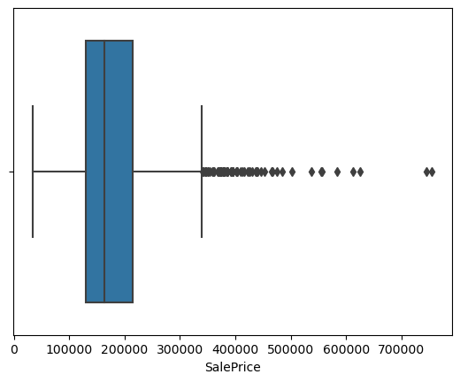
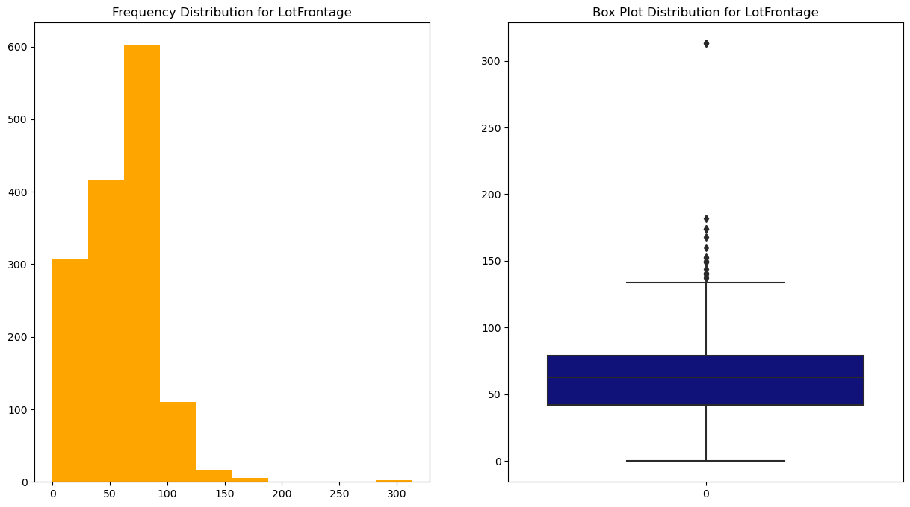
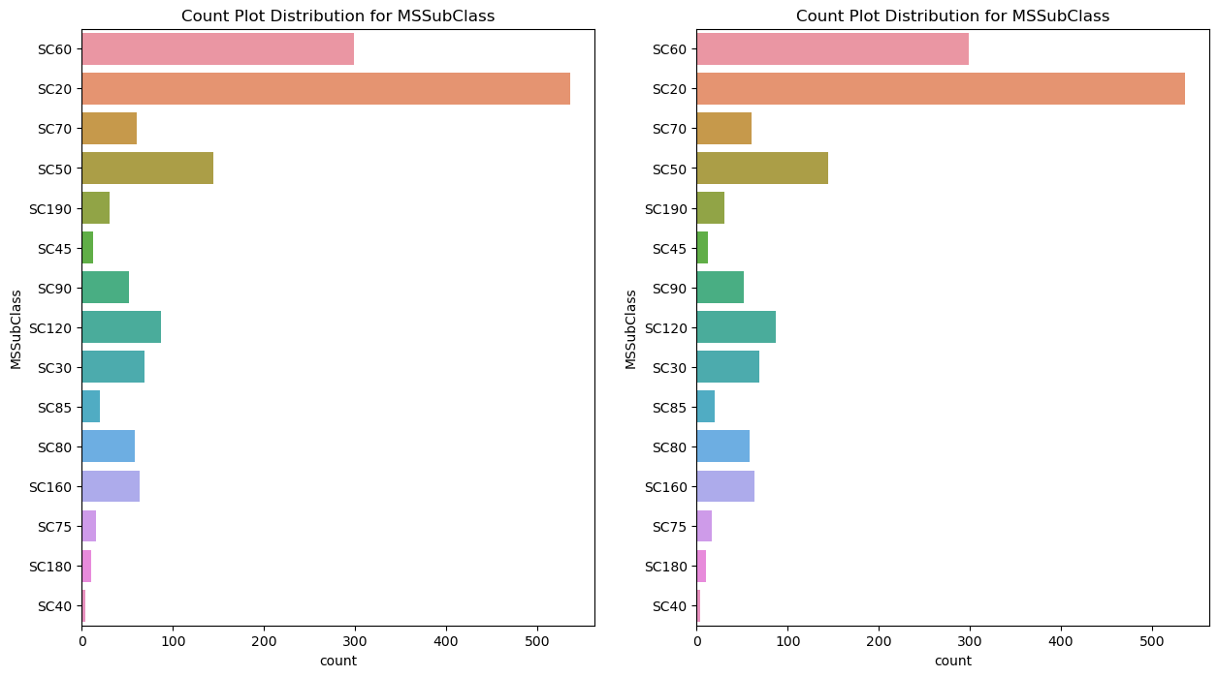
Live Demo Of EDA
Identifying the outliers
Univariate Analysis :
Example : Numeric & Categorical Columns

Slide 7
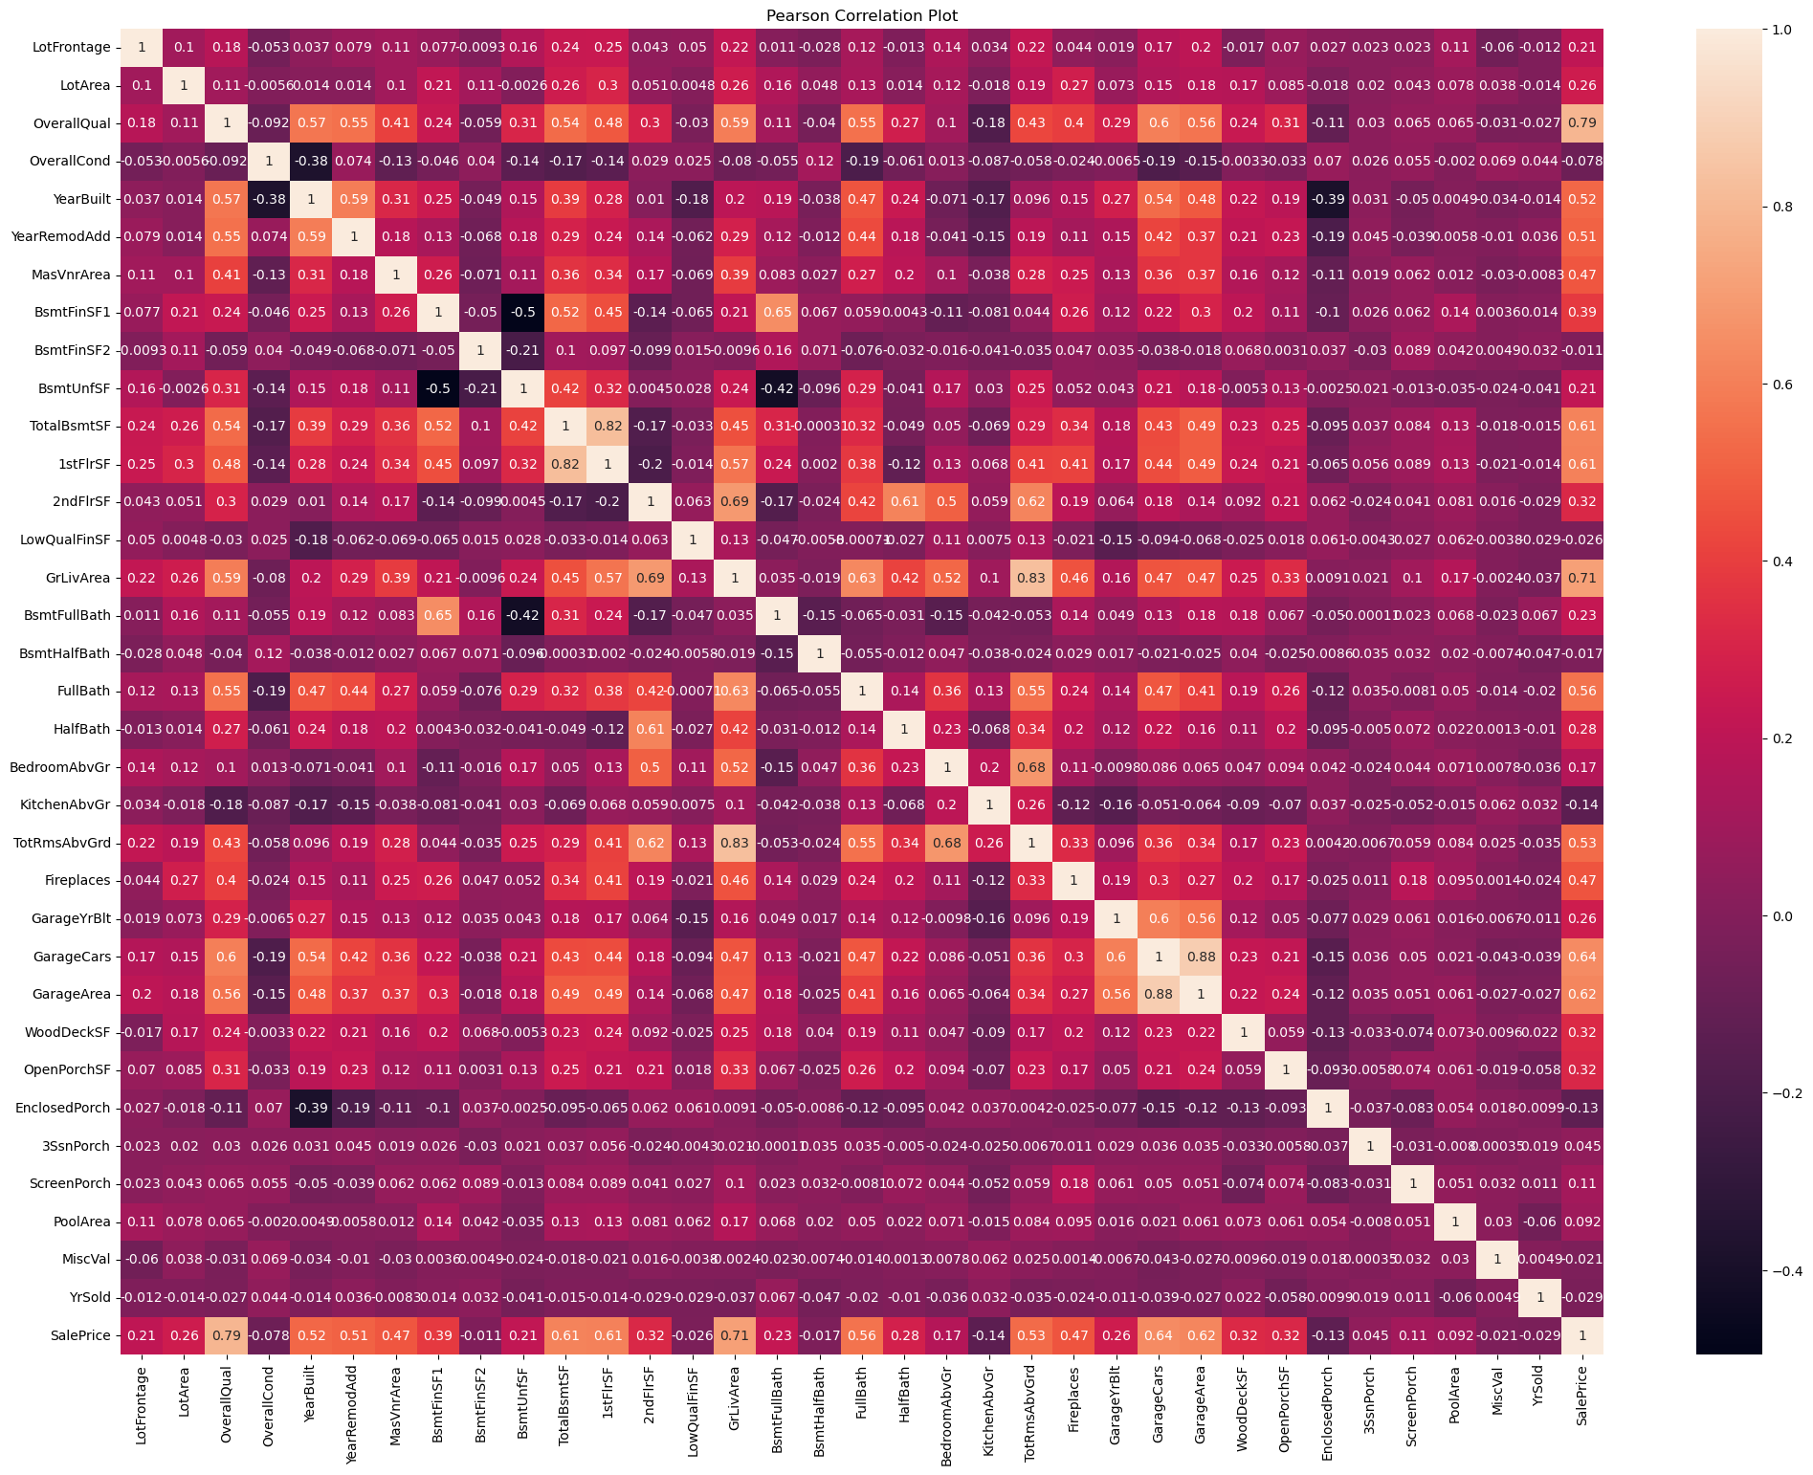
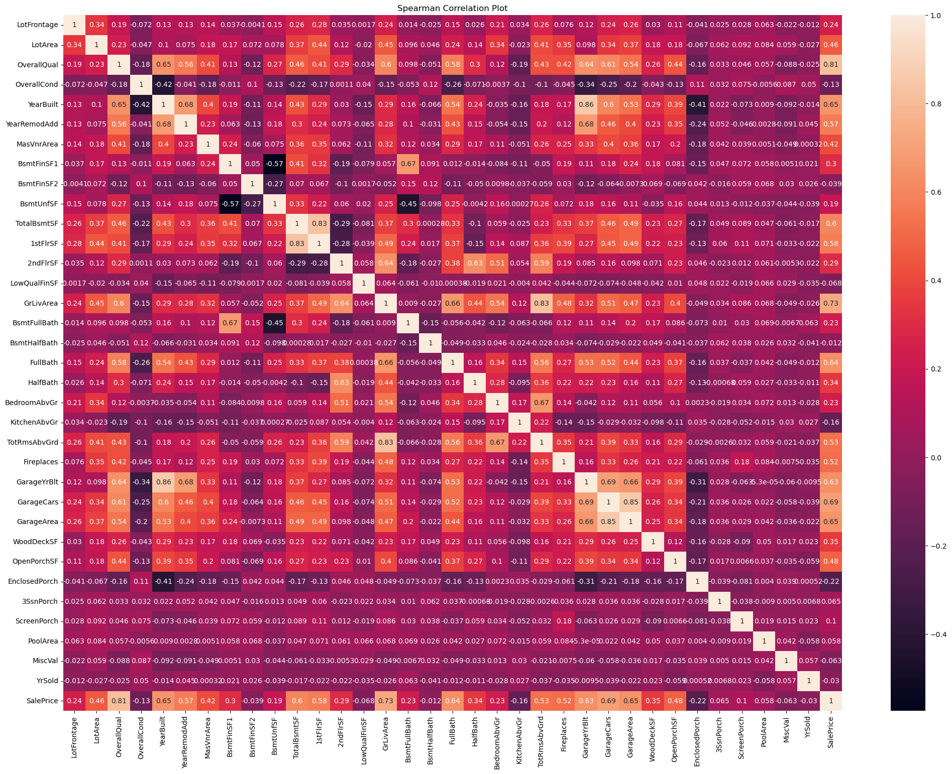
Live Demo Of EDA
Multivariate using Heatmap

Slide 8
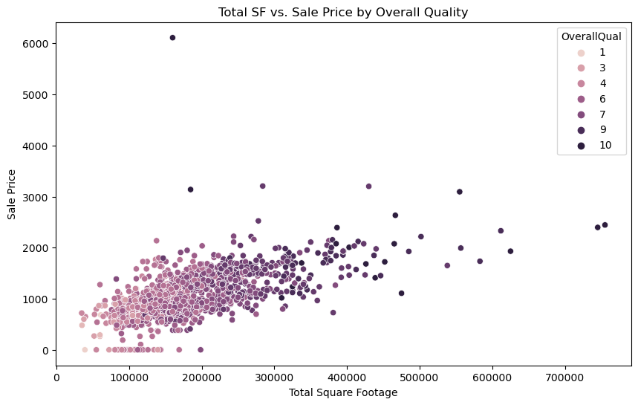
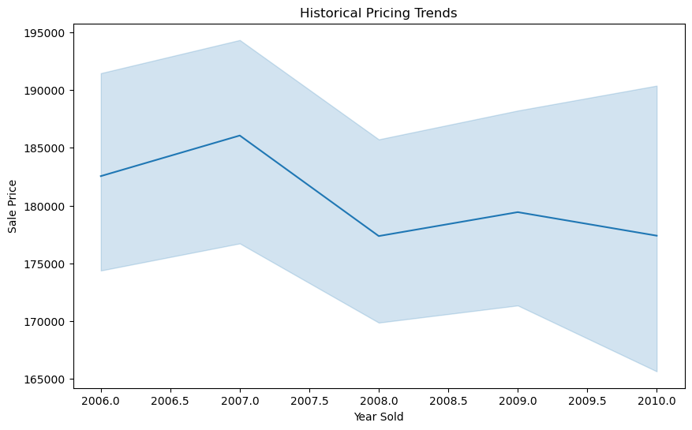
Live Demo Of EDA
The impact of features and size on house prices.
Historical pricing trends over time.

Slide 9
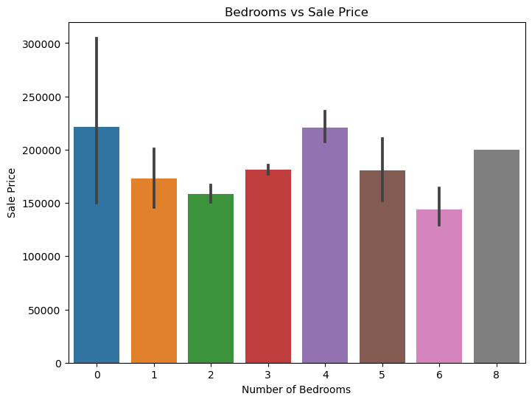
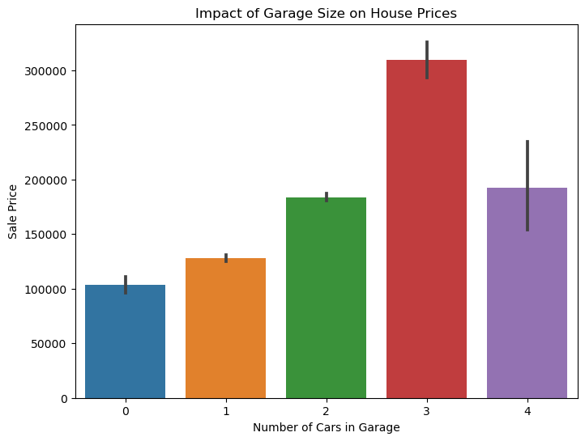
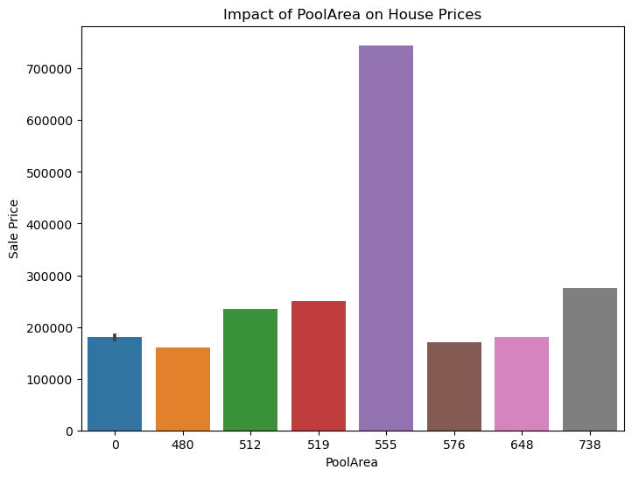
Live Demo for EDA
Customer Preferences and Amenities.

Slide 10
Conclusion
In the Exploratory Data Analysis for Real Estate Pricing project, a systematic approach was employed. The initial steps involved the identification and handling of duplicate rows, along with the strategic treatment of missing values through either deletion or imputation based on the nature of the data. The quantitative features were meticulously examined for outlier identification and minimal treatment was carried out. Extensive EDA and visualization were performed, providing insights into the distribution of Numeric & Categorical Columns.
Feature Engineering, Market Trends and Historical Pricing, Customer Preferences and Amenities has been performed.

Slide 11
THANK YOU

